Slide 1
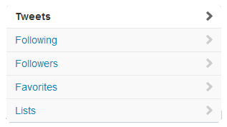
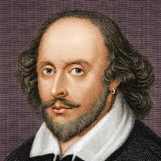
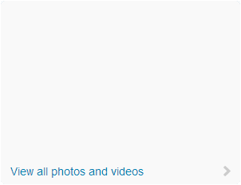
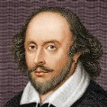
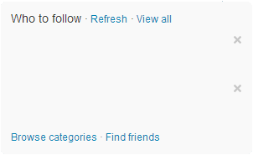
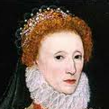
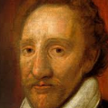
PERSON’S NAME
@TWITTERNAME
One line description of person
Location– website
PERSON”S NAME
@TWITTERNAME
14,234
5,321
3,445,234
Person’s Name @twittername 3m
TWEET
Person’s Name @twittername 2d
TWEET
Expand
Person’s Name @twittername 2d
TWEET
Retweeted by William Shakespeare
Person2 @twitter2
Followed by follower2 and others
Follow
Person3 @Twittter3
Followed by follower1 and others
Follow
Person’s Name @twittername 1w
TWEET
Person’s Name @twittername 1w
TWEET

